Slide 1
React
Front End Libraries

Slide 2
Agenda
Recap
What is React
React Developer Tools
create-react-app
Sample React App
Consumes ReST API
A (super) quick recap and warm up to get back into React shape
A refresher, not a re-teaching of React

Slide 3
What is React
Open-source, front-end JavaScript library for building user interfaces and UI components
Maintained by Facebook and a community of developers
Base for SPA (Single Page Applications) and Mobile Applications
Create simple design “Declarative Views” to render your pages as blocks
Component-based and built in JavaScript and XML (JSX)
All components implement a render() method that takes input data and returns what to display

Slide 4
What is React
React can render on a server created in node or on mobile using React Native
The ‘R’ in MERN stack (MongoDb, Express, React, NodeJS) – JS-focused stack
Analogous to the ‘V’ in MVC. The view layer of your application.
Re-usable components with their own state
Dynamic, Performant
Virtual DOM (no need for a big reload, just update components)

Slide 5
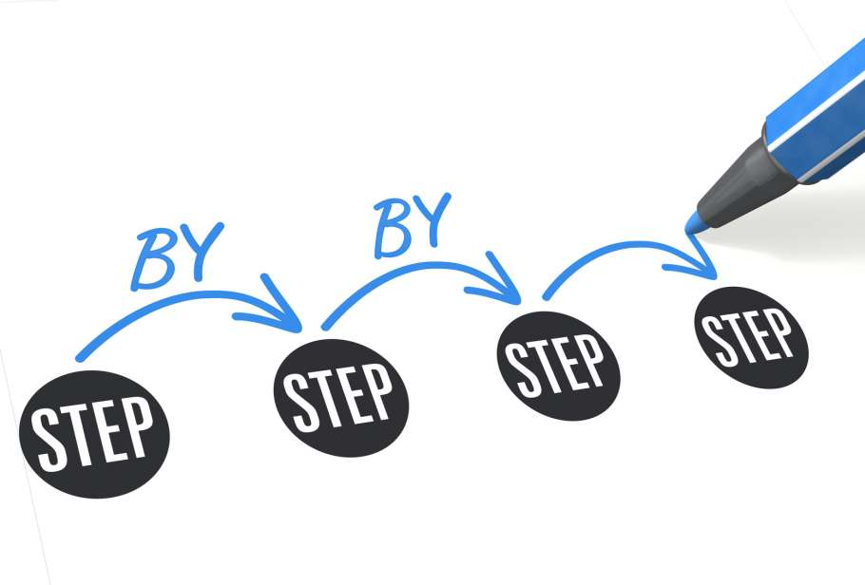
Goal
Create a React application that consumes ReST API
Refresh knowledge of React
Provide template for later work
Sample ReST API
https://jsonplaceholder.typicode.com/users/
Pull this URL up and take a look
Notes:
Based on tutorial: https://medium.com/@nutanbhogendrasharma/step-by-step-consume-rest-api-in-react-application-48388f6c4d9c

Slide 6
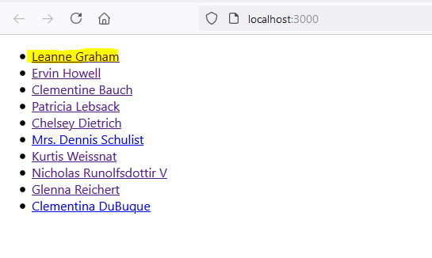
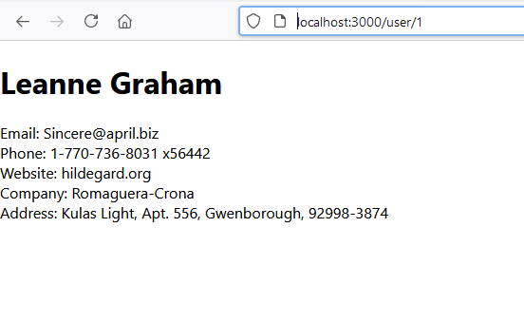
Goal
Notes:
We will consume the ReST API to get the full list of users, then if a user is clicked on, provide details for that user

Slide 7
Step 1: Install create-react-app
No one creates a React App from scratch
Use the create-react-app tool
Open a command shell
npm install -g create-react-app
Notes:
https://flaviocopes.com/vite-react-app/
Tbd copy from H30, update with vite

Slide 8
Step 2: Create React Application
In your H60- folder
React
cd to your React folder
npx create-react-app consume-rest-api
OR
npm create vite@latest
This will download and setup a template project
Can take a couple minutes (in the meanwhile, read the https://jsonplaceholder.typicode.com/guide/
Analyze the raw data formats that will be returned from the ReST query
Notes:
Alternately, you could have https://flaviocopes.com/vite-react-app/

Slide 9
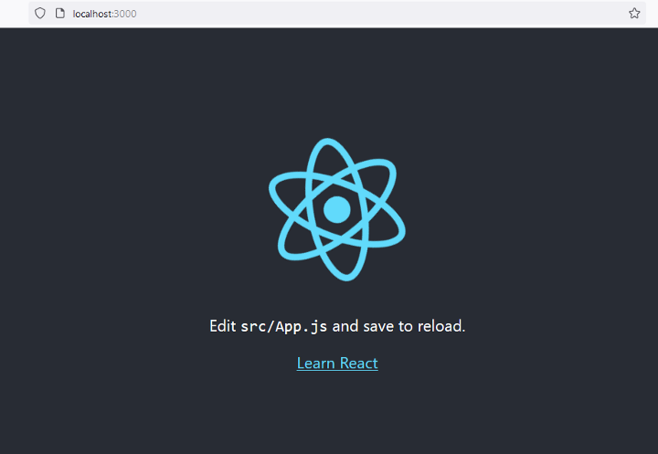
Step 3: Run the application
Just to make sure everything installed properly
React
cd consume-rest-api
npm start
This will startup your templated app.

Slide 10


Reflection point
What have we done so far?
Created a templated React App
Proved it runs
What comes next?
Create some dummy pages
They do nothing, but we’ll add in functionality later
Notes:
We build things in increments. We’re not trying to hit it out of the ballpark!

Slide 11
Step 4: Install react-router
To support what looks like paging and routing in the app
React
npm install react-router-dom --save

Slide 12
Goal
Notes:
We will consume the ReST API to get the full list of users, then if a user is clicked on, provide details for that user

Slide 13
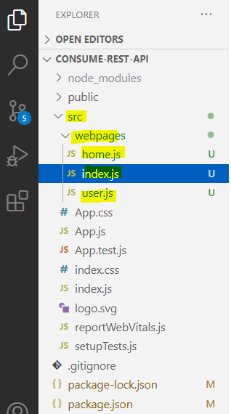
Step 6: Create Dummy pages
Open your project folder in Visual Studio Code
Create (empty for now)
. src/webpages/home.js
. src/webpages/user.js
. src/webpages/index.js
Notes:
Yes, create a webpages subfolder if you need to

Slide 14
src/webpages/home.js
import React from 'react';
const Home = () => {
return(
<div>
<h1>User Lists</h1>
</div>
);
}
export default Home;
Notes:
import React from 'react';
const Home = () => {
return(
<div>
<h1>User Lists</h1>
</div>
);
}
export default Home;

Slide 15
src/webpages/user.js
import React from 'react';
const User = () => {
return(
<div>
<h1>User Details</h1>
</div>
);
}
export default User;
Notes:
import React from 'react';
const User = () => {
return(
<div>
<h1>User Details</h1>
</div>
);
}
export default User;

Slide 16
src/webpages/index.js
import React from 'react';
import {
BrowserRouter,
Routes,
Route,
Link,
} from "react-router-dom";
import Home from './home';
import User from './user';
const Webpages = () => {
return(
<BrowserRouter>
<Routes>
<Route path="/" element={<Home />} />
<Route path="users" element={<User />} />
</Routes>
</BrowserRouter>
);
};
export default Webpages;
Notes:
import React from 'react';
import {
BrowserRouter,
Routes,
Route,
Link,
} from "react-router-dom";
import Home from './home';
import User from './user';
const Webpages = () => {
return(
<BrowserRouter>
<Routes>
<Route path="/" element={<Home />} />
<Route path="users/" element={<User />} />
</Routes>
</BrowserRouter>
);
};
export default Webpages;

Slide 17
src/App.js
import React from 'react';
import Webpages from './webpages/index.js';
function App() {
return (
<div>
<Webpages />
</div>
);
}
export default App;

Slide 18
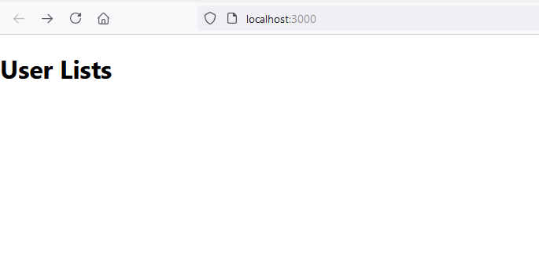
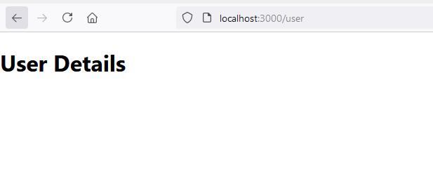
Step 7: Test Dummy Pages
Incremental check that all is good
npm start
Check URLs in browser:
http://localhost:3000/
http://localhost:3000/users

Slide 19
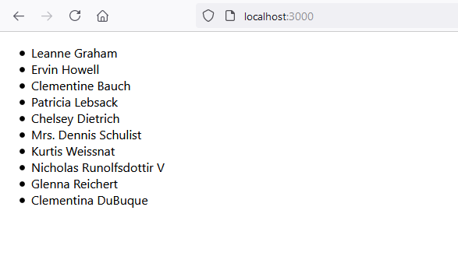
Step 8: Our first ReST Get
Do a Fetch from the API and build up the list on the home page
Notes:
Great.
We’re building functionality on the dummy pages

Slide 20
src/webpages/home.js
import React, { useState, useEffect } from 'react';
const Home = () => {
const [error, setError] = useState(null);
const [isLoaded, setIsLoaded] = useState(false);
const [users, setUsers] = useState([]);
useEffect(() => {
fetch("https://jsonplaceholder.typicode.com/users/")
.then(res => res.json())
.then(
(data) => {
setIsLoaded(true);
setUsers(data);
},
(error) => {
setIsLoaded(true);
setError(error);
}
)
}, [])
if (error) {
return <div>Error: {error.message}</div>;
} else if (!isLoaded) {
return <div>Loading...</div>;
} else {
return (
<ul>
{users.map(user => (
<li key={user.id}>
{user.name}
</li>
))}
</ul>
);
}
}
export default Home;
Notes:
import React, { useState, useEffect } from 'react';
const Home = () => {
const [error, setError] = useState(null);
const [isLoaded, setIsLoaded] = useState(false);
const [users, setUsers] = useState([]);
useEffect(() => {
fetch("https://jsonplaceholder.typicode.com/users/")
.then(res => res.json())
.then(
(data) => {
setIsLoaded(true);
setUsers(data);
},
(error) => {
setIsLoaded(true);
setError(error);
}
)
}, [])
if (error) {
return <div>Error: {error.message}</div>;
} else if (!isLoaded) {
return <div>Loading...</div>;
} else {
return (
<ul>
{users.map(user => (
<li key={user.id}>
{user.name}
</li>
))}
</ul>
);
}
}
export default Home;

Slide 21
Our first ReST Get
Validate that the ReST fetch worked
(just check your browser if you left the app running). Hot reloading!
Notes:
Great.
We’re building functionality on the dummy pages

Slide 22
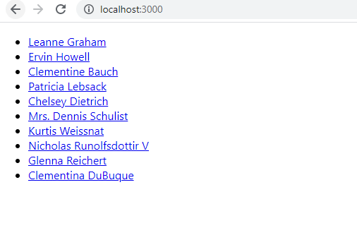
Step 9: Link that list to details
Make the list linkable to details
Notes:
Great.
We’re building functionality on the dummy pages

Slide 23
src/webpages/home.js
In the success case, in the return (), change to:
<ul>
{users.map(user => (
<li>
<Link to={`users/${user.id}`}>{user.name}</Link>
</li>
))}
</ul>
For the Link to work, you will need to import it (at top of file):
import {
Link
} from "react-router-dom";
Notes:
import {
Link
} from "react-router-dom";
// note those single quotes are ` not ‘

Slide 24
Verify
Run to make sure you have the links
Notes:
Great.
We’re building functionality on the dummy pages

Slide 25
Step 10: Route to the User detail
Make the list linkable to details
src/webpages/index.js
<BrowserRouter>
<Routes>
<Route path="/" element={<Home />} />
<Route path="users/:id" element={<User />} />
</Routes>
</BrowserRouter>
Notes:
Great.
We’re building functionality on the dummy pages

Slide 26
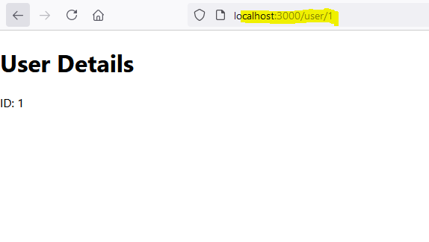
Step 10: Route to the User detail
For now, just validate that you can print out the ID and the routing works
src/webpages/user.js
import { useParams } from 'react-router-dom’;
Inside the User element:
// input parameter from URL
let { id } = useParams();
….
return(
<div>
<h1>User Details</h1>
ID: {id}
</div>
);
Notes:
Great.
We’re building functionality on the dummy pages

Slide 27
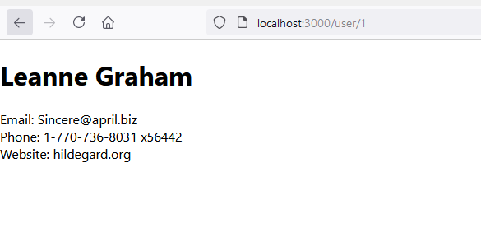
Step 11: Fetch and get details
Do a Fetch and display the details
src/webpages/user.js
See notes of this slide for source code
Notes:
import React, { useState, useEffect } from 'react';
import { useParams } from 'react-router-dom';
const User = () => {
// input parameter from URL
let { id } = useParams();
const [error, setError] = useState(null);
const [isLoaded, setIsLoaded] = useState(false);
const [user, setUser] = useState([]);
useEffect(() => {
fetch("https://jsonplaceholder.typicode.com/users/" + id)
.then(res => res.json())
.then(
(data) => {
console.log(data);
setUser(data);
setIsLoaded(true);
},
(error) => {
setIsLoaded(true);
setError(error);
}
)
}, [])
if (error) {
return <div>Error: {error.message}</div>;
}
if (!isLoaded) {
return <div>Loading...</div>;
}
if (user) {
return (
<div>
<h1>{user.name}</h1>
<div>
Email: {user.email}
</div>
<div>
Phone: {user.phone}
</div>
<div>
Website: {user.website}
</div>
</div>
);
}
}
export default User;

Slide 28
Step 12: Display other details
Do a Fetch and display the details
src/webpages/user.js
See notes of this slide for source code
const [userAddress, setUserAddress] = useState([]);
const [userCompany, setUserCompany] = useState([]);
setUserAddress(data.address);
setUserCompany(data.company);
Notes:
import React, { useState, useEffect } from 'react';
import { useParams } from 'react-router-dom';
const User = () => {
// input parameter from URL
let { id } = useParams();
const [error, setError] = useState(null);
const [isLoaded, setIsLoaded] = useState(false);
const [user, setUser] = useState([]);
const [userAddress, setUserAddress] = useState([]);
const [userCompany, setUserCompany] = useState([]);
useEffect(() => {
fetch("https://jsonplaceholder.typicode.com/users/" + id)
.then(res => res.json())
.then(
(data) => {
console.log(data);
setUser(data);
setIsLoaded(true);
setUserAddress(data.address);
setUserCompany(data.company);
},
(error) => {
setIsLoaded(true);
setError(error);
}
)
}, [])
if (error) {
return <div>Error: {error.message}</div>;
}
if (!isLoaded) {
return <div>Loading...</div>;
}
if (user) {
return (
<div>
<h1>{user.name}</h1>
<div>
Email: {user.email}
</div>
<div>
Phone: {user.phone}
</div>
<div>
Website: {user.website}
</div>
<div>
Company: {userCompany.name}
</div>
<div>
Address: {userAddress.street}, {userAddress.suite}, {userAddress.city}, {userAddress.zipcode}
</div>
</div>
);
}
}
export default User;

Slide 29
Reflection point
What have we done so far?
Created a templated React App
Proved it runs
Implemented a ReST back end
React provides JSX (JavaScript as XML) to make this easier
Tag-based syntax that can be used to create React elements
Instead of all the createElement calls can use JSX syntax

Slide 30
Reflection point
More recap follows (slides)
Blatantly stolen from Web III as a refresher

Slide 31
Refactoring Elements Using JSX
Seen how to render a React element to the DOM
Nest CreateElement attributes as deeply as you want, but this becomes confusing very quickly
React provides JSX (JavaScript as XML) to make this easier
Tag-based syntax that can be used to create React elements
Instead of all the createElement calls can use JSX syntax
Notes:
Comment out title
Use ReactDom.render(<div>
<h1>Hello World</h1>
<p>Yay</p>
</div>,
document.querySelector("#root")
Add style={style} to h1 or div to provide styling

Slide 32
Create a React Component Using Class
Popularity of React comes from the ability to create components
Create a User Interface by creating and nesting a collection of components
Initial Way was using JavaScript classes extending the React.Component class
All React components have a render method to allow them to be displayed
All React components must start with a capital letter
Requirement so that they are never confused with regular HTML elements
Notes:
Copy index.js to index.jsxrender.js
Edit original index.js
Remove style and Add
class Message extends React.Component {
render() {
return (
<div>
<h3>Hello Everybodeeeeee</h3>
</div>
)
}
}
ReactDOM.render(<Message/>, document.querySelector("#root"))

Slide 33
Add Component Properties
To make information dynamic as it is displayed use React Properties (called ‘props’)
Add data during render and then it is available to the component object to use
Add to rendered component as attributes of the component
<Message color=“blue” msg=“Hello” />
Can be data to be displayed, formatting data or almost anything you want to use
If value is not a string it needs to be passed as a JSX expression (in curly brackets)
<Message color=“blue” msg=“Hello” count={100} />

Slide 34
More Properties
Can add objects and data to a component to have more complex messaging
Add whatever data you want but usually JSON objects
Code can get cumbersome and complex quickly
Shorten the code by destructuring the Component during the import
import React, {Component} from ‘react’
Must include React in all files that are using JSX syntax
Can destructure render from react-dom as well
Can also destructure this.props in a component to make code read better

Slide 35
Custom Methods
Can add methods that are local to the components
Put methods within the class and use them in the render method of the class
Same as all other class methods that are used
Simply call the functions as you would with any other class
Do not actually have to use a class can do all the same things with just functions
Called Functional Components

Slide 36
Compose Components
Power of React comes from composing multiple different components
Tempting to use the render method and just add new components one on top of the other, but there is a better way
A component can be rendered within a parent component
Can have data that is sent to parent and use array functions to ‘map’ the data to a child function
Notes:
Do example with library and books

Slide 37
Class vs Functions for Components
Use Classes or Functions to create components
Class Component
Regular JavaScript class that extends Component Class of React library
Stateful because it controls how the state changes using component logic
Create class with constructor to set state
Use render method to display
Create functions to do the work of changing the state object using this.setState
Functional Components
Use JavaScript functions
Usually stateless, but can keep state using something called React hooks
Creating components is more straightforward using functions and hooks
Use useState and useEffect hooks

Slide 38
Functional Components
No constructor or render methods since it’s just a function
useState hook add states to functional components
Returns a pair of values: the current state and a function that updates that state
Then define that function based on actions on the page
Also useEffect hook which is run as soon as the component is rendered
Has a second component so will only run on each element of the second component

Slide 39
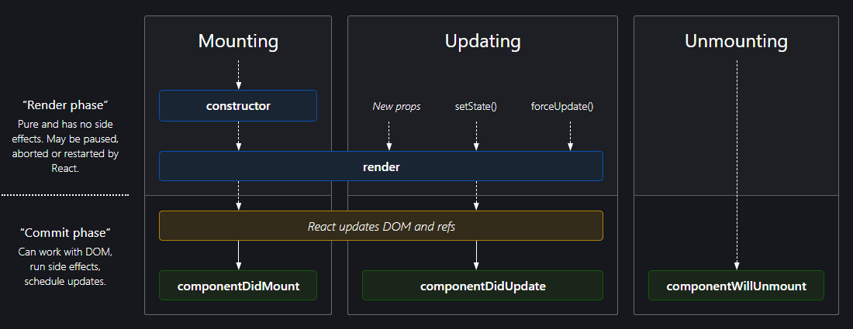
Component Lifecycle
Provides functions that are invoked at specific times during rendering lifecycle
Notes:
Mounting and unmounting are whenever component is added or taken away from the DOM

Slide 40
Resources
https://reactjs.org/
Starting point
Tutorials
References

